Slide 1

SURAKSH-MAA

Slide 2
PROBLEM BEING ADDRESSED :
The death of women during delivery of child is still a case to be addressed.
The lack of awareness in rural areas , the unavailability of doctors and health counsellors , lack of education on women/mother heal are primary cause of such death cases.
SOLUTION :
A technological solution is an innovative app SURAKSH-MAA which provides timely reminders regarding healthcare and also helps to connect to nearby hospital during emergency situations.

Slide 3
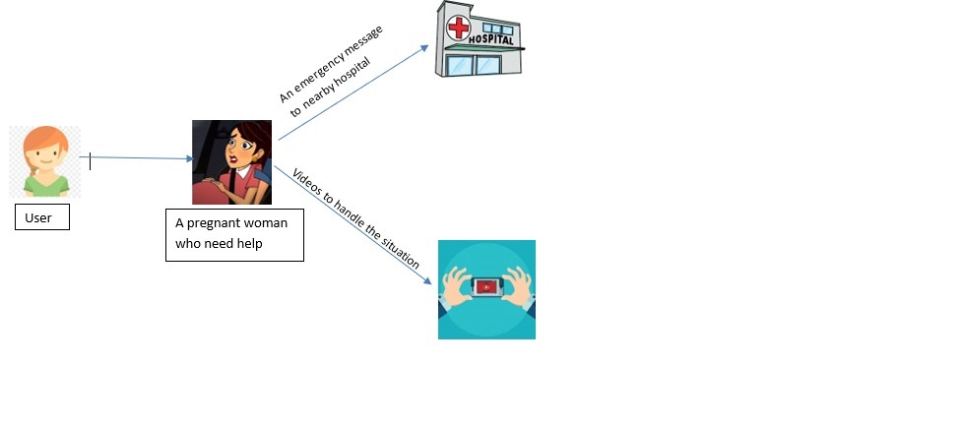
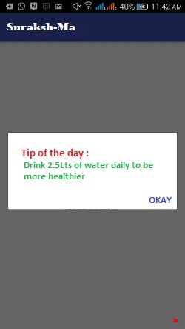
USE CASE
SAMPLE IMAGE OF APPLICATION

Slide 4
PRODUCT :
SURAKSH-MAA creates awareness to pregnant women regarding monthly symptoms and a clear idea about baby development.
It allows users to connect to nearby hospital or any PHC on one tap.
It also sends SMS alert to first five trusted contacts with location during emergency.
It gives information about care and tips to be followed during each and every month.
The app provides “tip of the day “ to the user which makes it more user-friendly.
The users can access the app in 3 different languages in which they are comfortable with.

Slide 5
VALUE PROPOSITION
The unique feature of our app is that it sends SMS alert to first five trusted contacts during emergency and connecting to nearby hospitals on single tap.
Our app aims at making the life of pregnant women easier by giving awareness regarding monthly symptoms.

Slide 6
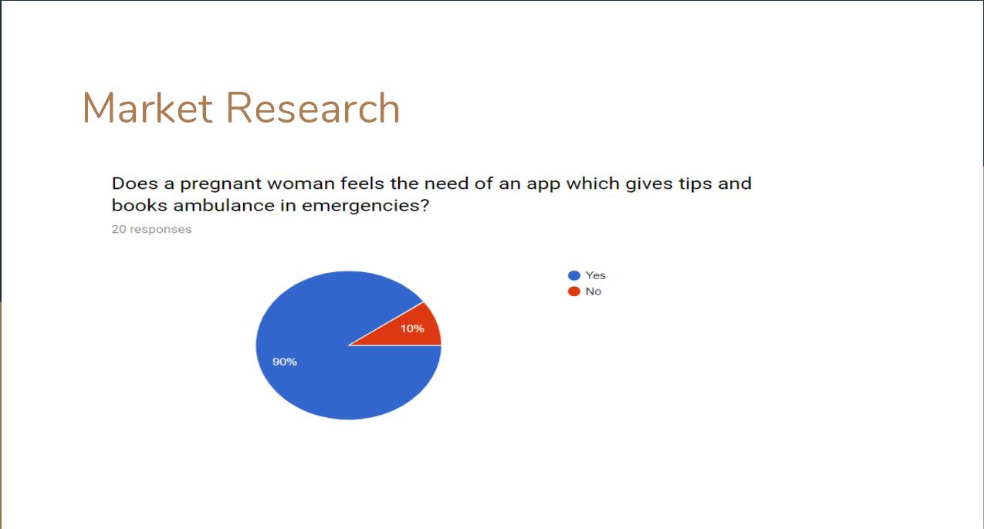
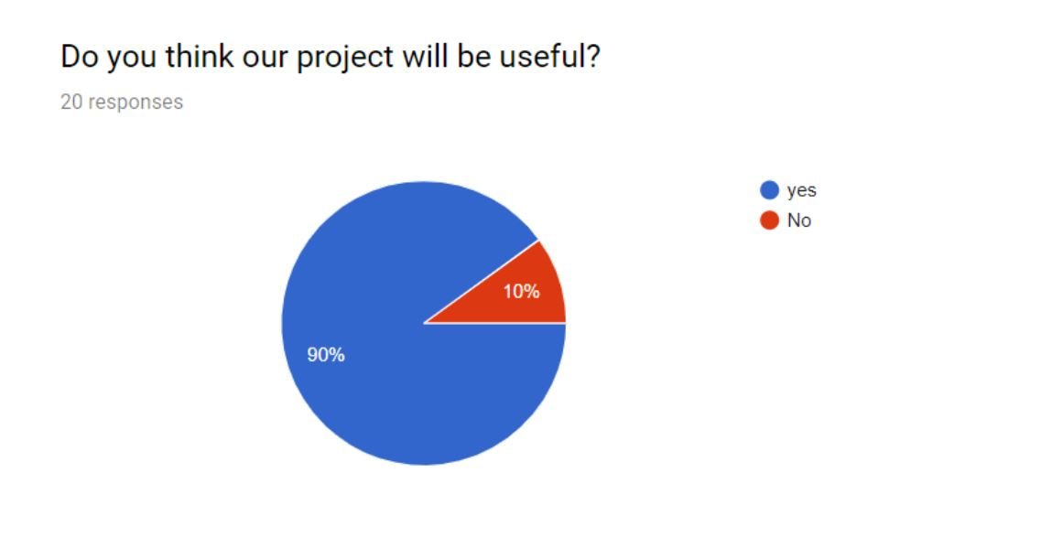
Any pregnant women is our possible market user.

Slide 7

COMPETITION
Our Competitors are other similar applications which
are build with motto of helping pregnant women.
Few of them are –
BabyCenter
Totally Pregnant App

Slide 8

FINANCIALS
The major finance requirements are
Cost of uploading into play store
(25 USD for one time registration)

Slide 9
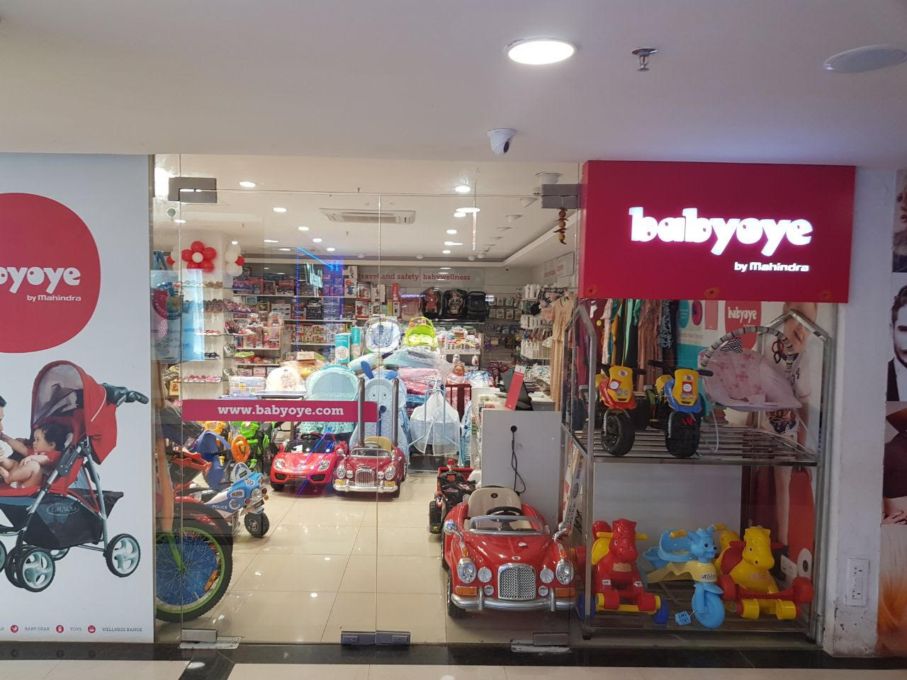

REVENUE MODEL
The revenue model of our app through monetizing.
This includes in-app advertisements relevant to our app.

Slide 10

MARKETING STRATEGY
We will reach out customers through
Social media
Posters in PHC's
Self-help groups
Contact with NGOs
Word of mouth

Slide 11
TEAM
VASAVI SAI NUNNA - Team leader and the Dreamer
SAINATH OMDAS - The Visionary
YASHASWINI POTU - The Doer
MANIDEEP PASULADI - The Connector
ASHWIK SAGI - The Architect

Slide 12


